Slide 1
SPATIAL FILTERING in Digital Image Processing
By,
GROUP 5

Slide 2
TOPICS COVERED :
Introduction and mechanics of spatial filtering
Spatial correlation and convolution
Smoothing spatial filters
Sharpening spatial filters
Combining spatial enhancement methods

Slide 3
Introduction and mechanics of Spatial Filtering

Slide 4

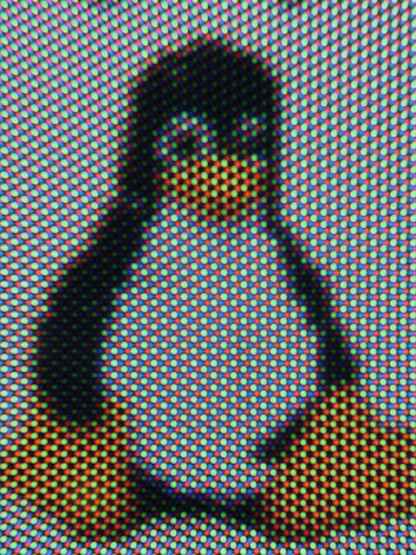
SPATIAL FILTERING
Say Hi to TUX , the mascot of LINUX.
Introduction
Made and Presented by ,
Husein.R.Khilawala

Slide 5
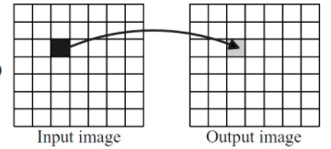
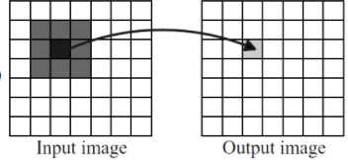
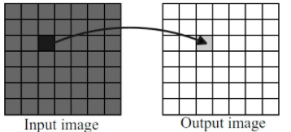
Two types of operations
SPATIAL FILTERING
Introduction
Point operations
Neighbourhood
operations
Whole operation
Made and Presented by ,
Husein.R.Khilawala

Slide 6
Why Spatial Filtering?
SPATIAL FILTERING
Introduction
Spatial filtering is commonly used to "clean up" the output of lasers, removing aberrations in the beam due to imperfect, dirty, or damaged optics, or due to variations in the laser gain medium itself.
Also used to enhance an image by applying certain functions which can make an image better or more useful to the real world.
We can filter an image to emphasize certain features or remove other features
E.g. Smoothing, Sharpening, And Edge Enhancement.
Made and Presented by ,
Husein.R.Khilawala

Slide 7
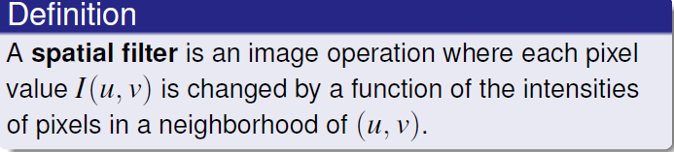
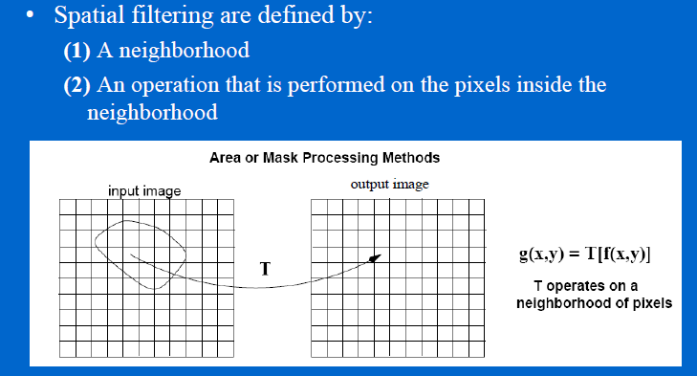
Lets get technical now!
SPATIAL FILTERING
Definition
Made and Presented by ,
Husein.R.Khilawala

Slide 8
The Spatial Filtering Process….
Working
Origin
x
a
b
c
r
s
t
d
e
f
*
u
v
w
g
h
i
x
y
z
Original Image Pixels
Filter
Simple 3*3 Neighbourhood
e
3*3 Filter
e_{processed} = v*e + r*a + s*b + t*c + u*d + w*f + x*g + y*h + z*i
y
Image f (x, y)
The above is repeated for every pixel in the original image to generate the filtered image
Made and Presented by ,
Husein.R.Khilawala

Slide 9
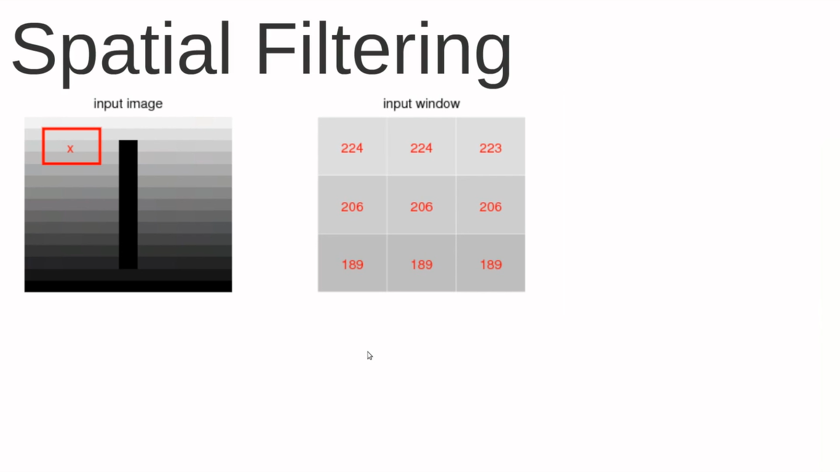
Made and Presented by ,
Husein.R.Khilawala

Slide 10
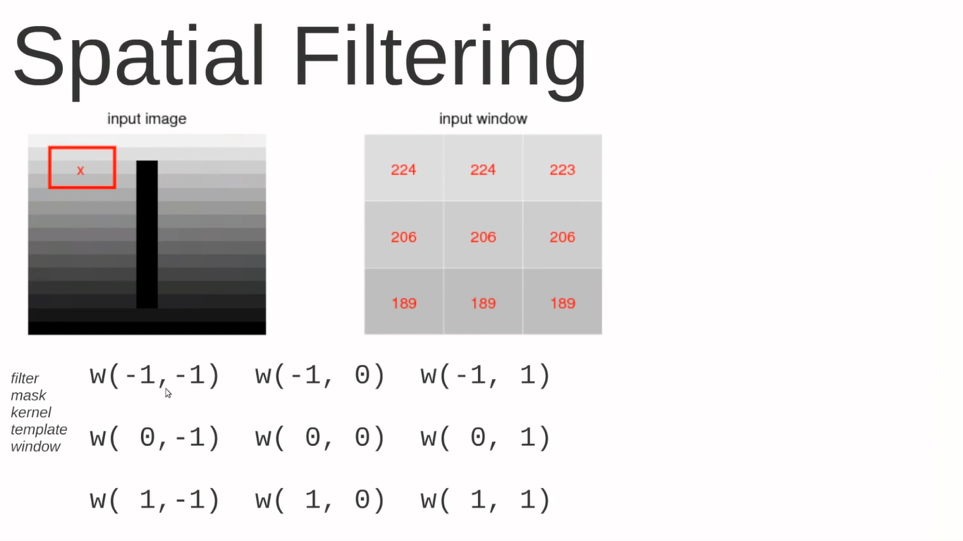
Made and Presented by ,
Husein.R.Khilawala

Slide 11

Made and Presented by ,
Husein.R.Khilawala

Slide 12
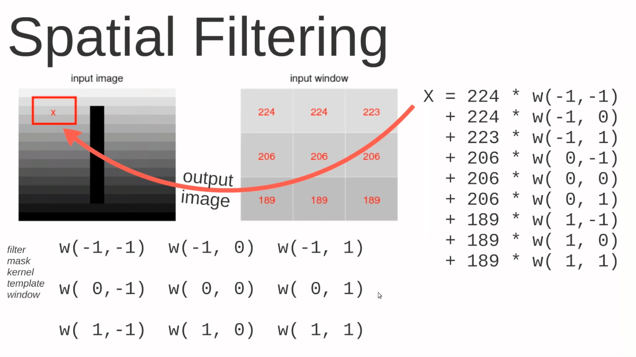
Made and Presented by ,
Husein.R.Khilawala

Slide 13
What can be done to nearby pixels?
Working
Min: Set the pixel value to the minimum in the neighbourhood
Max: Set the pixel value to the maximum in the neighbourhood
Median or Mean: The median value of a set of numbers is the midpoint value in that set (e.g. from the set [1, 7, 15, 18, 24] 15 is the median). Sometimes the median works better than the average(mean).
Made and Presented by ,
Husein.R.Khilawala

Slide 14
SPATIAL FILTERING EXAMPLES :
Examples

Slide 15
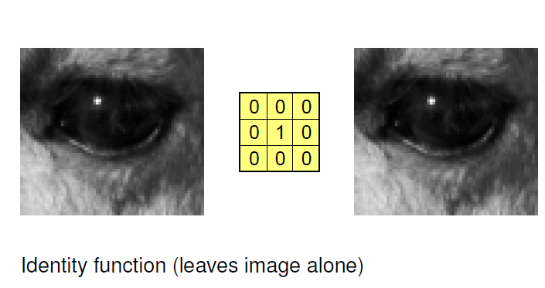
Examples
Made and Presented by ,
Husein.R.Khilawala

Slide 16
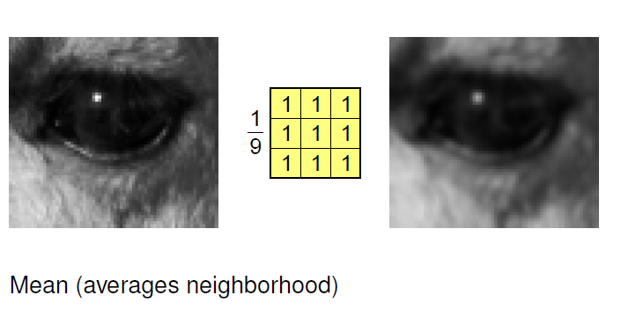
Examples
Made and Presented by ,
Husein.R.Khilawala

Slide 17
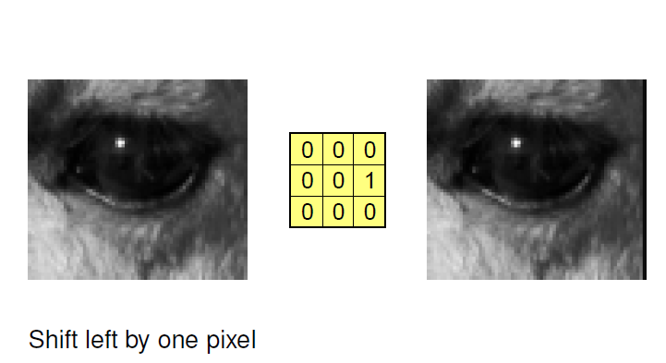
Examples
Made and Presented by ,
Husein.R.Khilawala

Slide 18
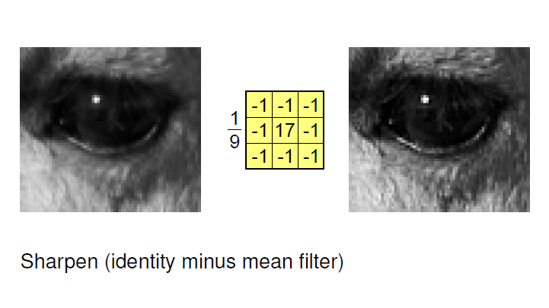
Examples
Made and Presented by ,
Husein.R.Khilawala

Slide 19
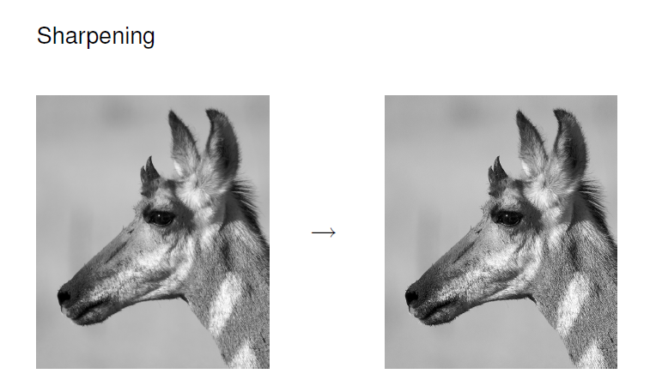
Examples
Examples
Made and Presented by ,
Husein.R.Khilawala

Slide 20
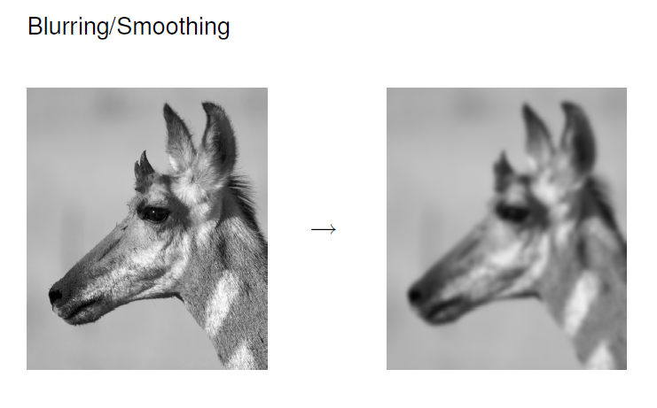
Examples
Made and Presented by ,
Husein.R.Khilawala

Slide 21
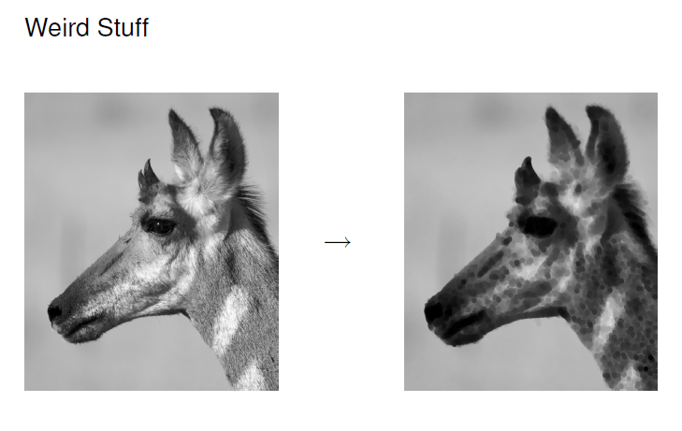
Made and Presented by ,
Husein.R.Khilawala

Slide 22
Spatial Correlation & Convolution

Slide 23
What is Correlation and convolution?
These are 2 closely related concepts in DIP.
Correlation and Convolution are basic operations that are used to extract information from images.
Correlation is the process of moving a filter mask over the image and computing the sum of products at each location.
Correlation is used to match a template to an image.
The mechanics of convolution are the same, except that the filter is first rotated by 180°.

Slide 24
Features
These operations have two key features :
1. shift-invariant :-
Shift-invariant means that we perform the same operation at every point in the image.
2. linear.
Linear means that this operation is linear, that is, we replace every pixel with a linear combination of its neighbours.

Slide 25
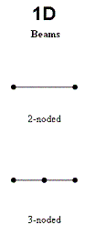
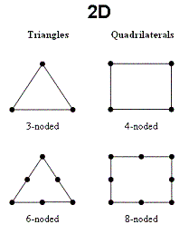
Types of Correlation and Convolution
Correlation and convolution can be performed on :
One Dimensional Image.
1D image as just a single row of pixels
Two Dimensional Image. 2D image
2D image as just a real life image with multiple rows of pixels

Slide 26
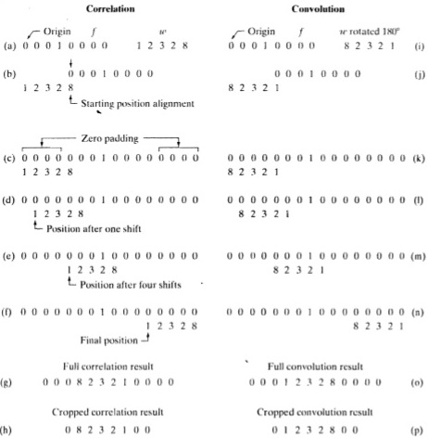
1D Correlation and Convolution

Slide 27
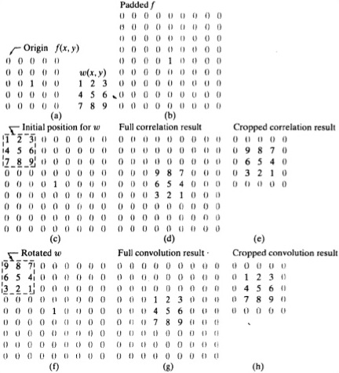
2D Correlation and Convolution

Slide 28
Spatial filters are classified into :
Spatial filters are classified into :
Smoothing Spatial Filters
Sharpening Spatial Filters

Slide 29
Smoothing Spatial Filters

Slide 30
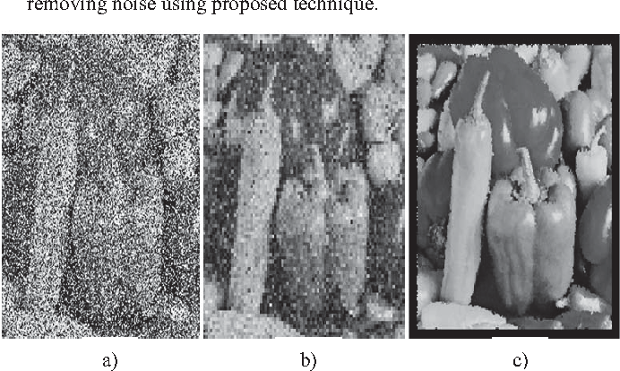
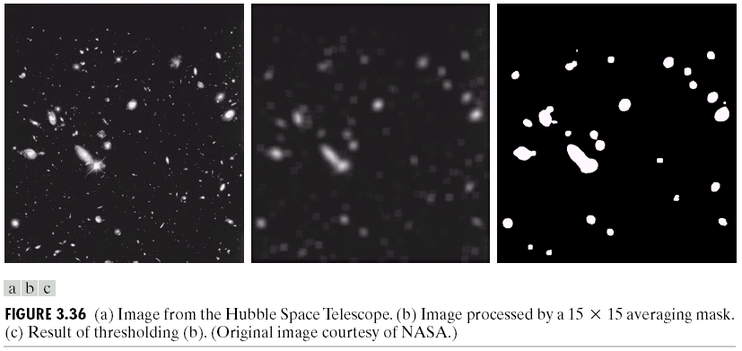
Smoothing Spatial Filters
Used for blurring
removes noise

Slide 31
Two techniques :
Averaging linear filters
Order-statistics filter

Slide 32
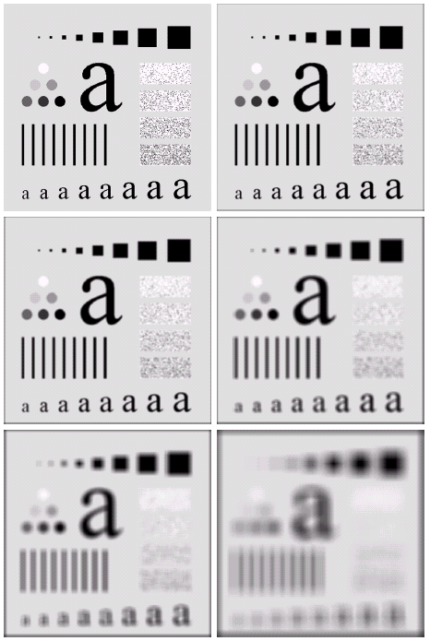
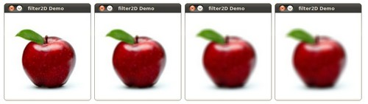
Averaging linear filters
Averaging filters
Output is smoothed image
Follow Linear approach

Slide 33
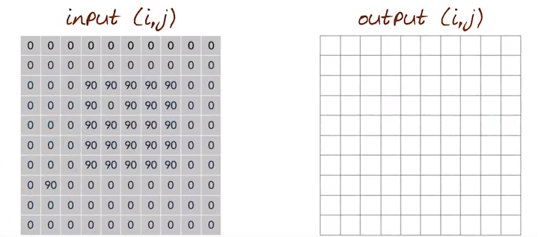

Slide 34
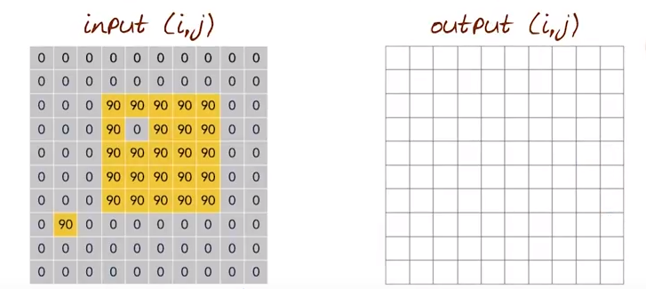

Slide 35
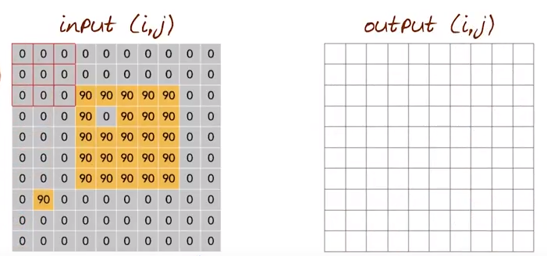

Slide 36
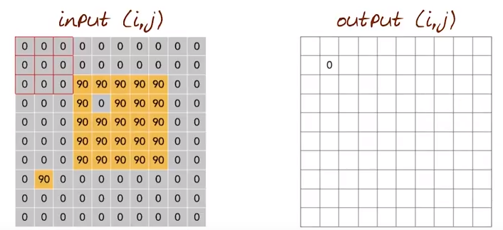

Slide 37
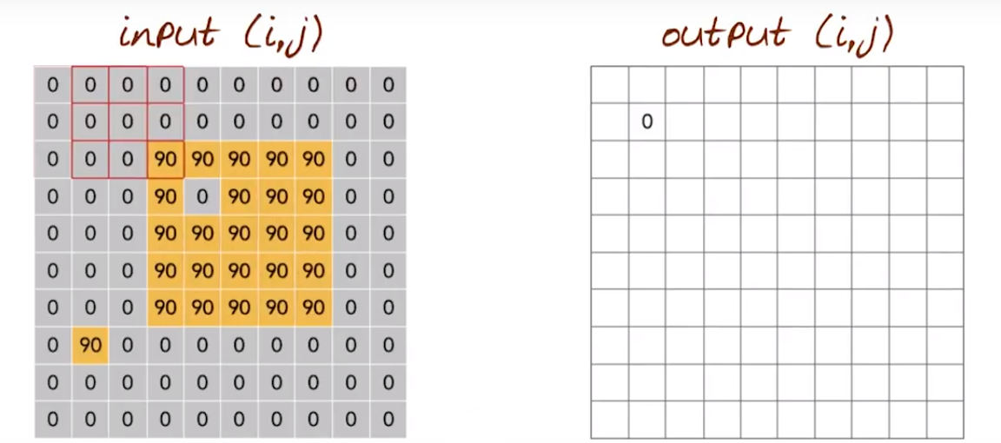

Slide 38
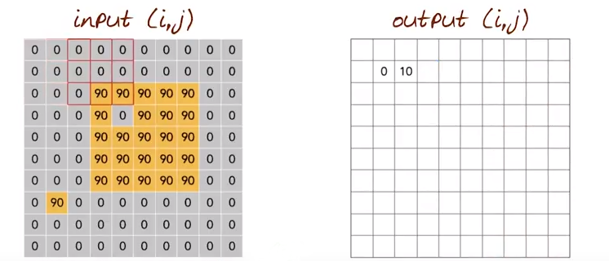

Slide 39
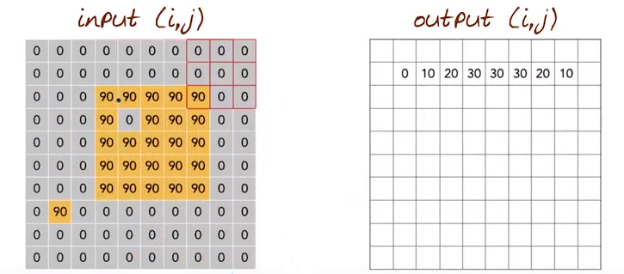

Slide 40
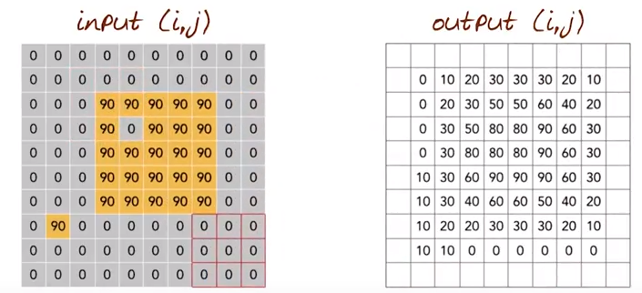

Slide 41
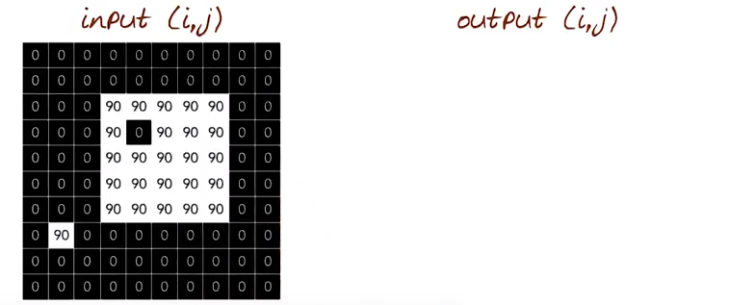

Slide 42
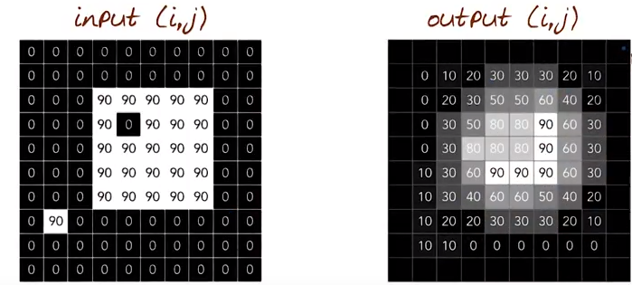

Slide 43
Effects of the average linear techniques are :
Blurring
Blending
Reduce image quality

Slide 44
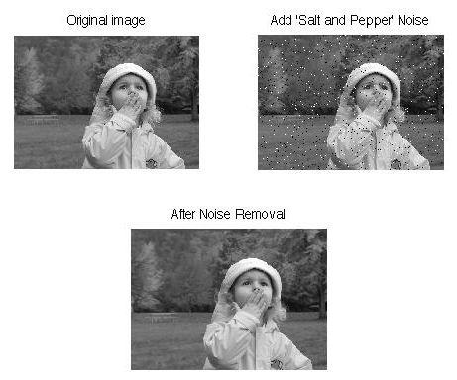
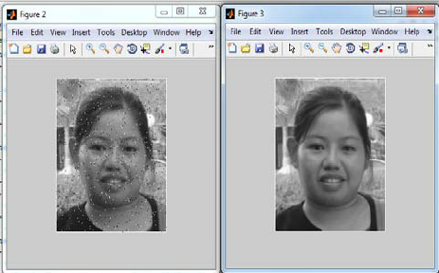
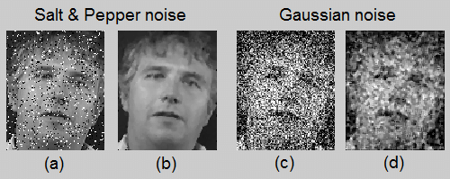
Order-statistics filter
Non-linear spatial filters
Sort the pixels
Median filter
Very effective for removing “salt and pepper” noise

Slide 45
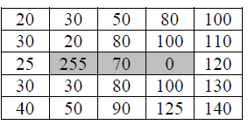
Consider the following 5x5 image :
Apply 3x3 median filter on shaded pixels, and write the filtered image.

Slide 46
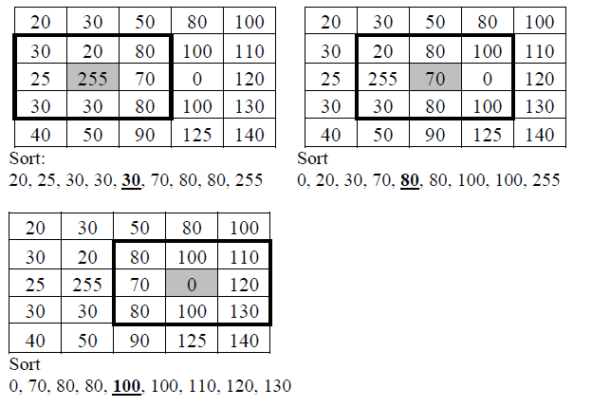
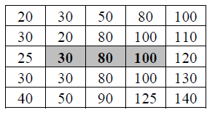
Final Output

Slide 47
Sharpening Spatial Filters

Slide 48
Sharpening Filters
Useful for highlighting fine details.
The elements of the mask contain both positive and negative weights.
Sum of mask elements is 0.

Slide 49
Sharpening Filters (cont’d)
Useful for highlighting fine details.
e.g., emphasize edges

Slide 50
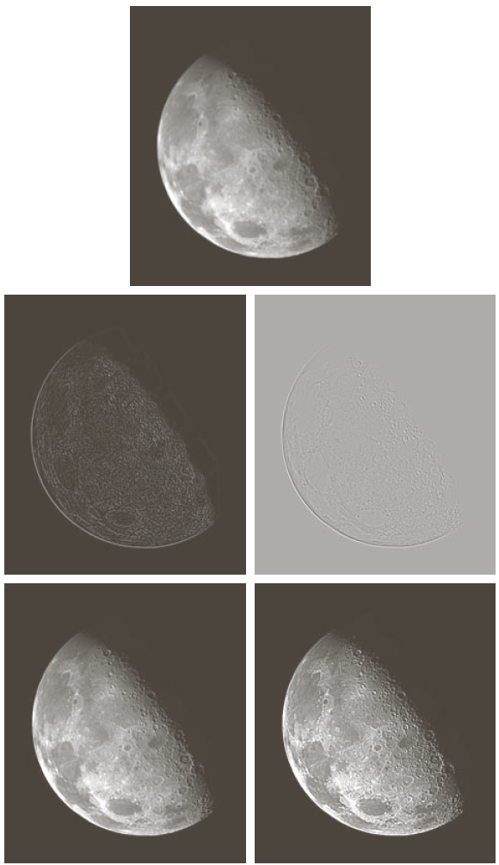
Sharpening Filters - Example
Note that the response of sharpening might be negative.
Values must be re-mapped to [0, 255]
input image
sharpened image

Slide 51
Sharpening Filters
Unsharp masking
High Boost filter
Gradient (1st derivative)
Laplacian (2nd derivative)

Slide 52



Sharpening Filters: Unsharp Masking
Obtain a sharp image by subtracting a lowpass filtered (i.e., smoothed) image from the original image:
-
=
(after contrast
enhancement)

Slide 53
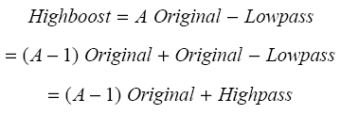

Sharpening Filters: High Boost
Image sharpening emphasizes edges but low frequency components are lost.
High boost filter: amplify input image, then subtract a lowpass image.
(A-1)
+
=

Slide 54
Sharpening Filters: High Boost (cont’d)
If A=1, we get unsharp masking.
If A>1, part of the original image is added back to the high pass filtered image.
One way to implement high boost filtering is using the masks below:

Slide 55
Sharpening Filters: High Boost (cont’d)
A=1.4
A=1.9

Slide 56
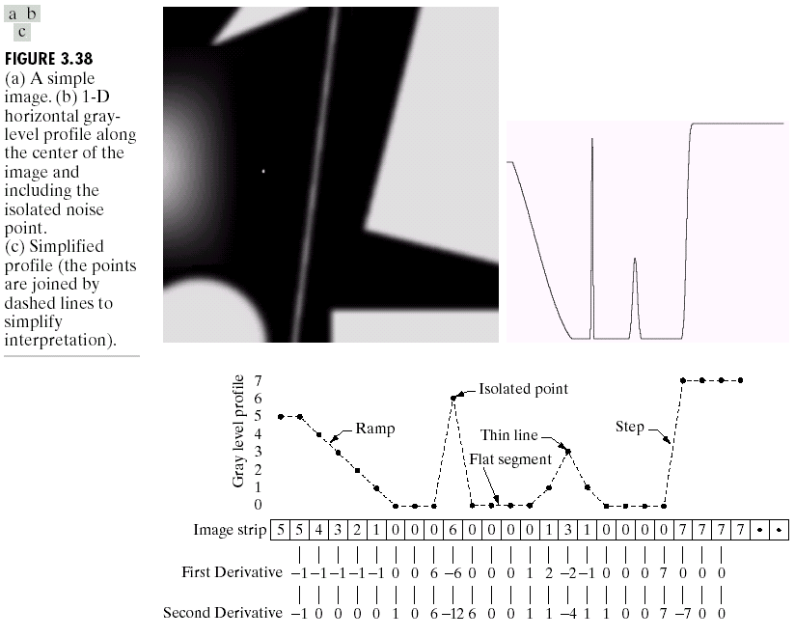
Spatial Differentiation
Differentiation measures the rate of change of a function
Let’s consider a simple 1 dimensional example

Slide 57
Spatial Differentiation
A
B

Slide 58
1st Derivative
The formula for the 1st derivative of a function is as follows:
It’s just the difference between subsequent values and measures the rate of change of the function

Slide 59
1st Derivative (cont…)
5 | 5 | 4 | 3 | 2 | 1 | 0 | 0 | 0 | 6 | 0 | 0 | 0 | 0 | 1 | 3 | 1 | 0 | 0 | 0 | 0 | 7 | 7 | 7 | 7
 | 0 | -1 | -1 | -1 | -1 | 0 | 0 | 6 | -6 | 0 | 0 | 0 | 1 | 2 | -2 | -1 | 0 | 0 | 0 | 7 | 0 | 0 | 0

Slide 60
2nd Derivative
The formula for the 2nd derivative of a function is as follows:
Simply takes into account the values both before and after the current value

Slide 61
2nd Derivative (cont…)
5 | 5 | 4 | 3 | 2 | 1 | 0 | 0 | 0 | 6 | 0 | 0 | 0 | 0 | 1 | 3 | 1 | 0 | 0 | 0 | 0 | 7 | 7 | 7 | 7
 | -1 | 0 | 0 | 0 | 0 | 1 | 0 | 6 | -12 | 6 | 0 | 0 | 1 | 1 | -4 | 1 | 1 | 0 | 0 | 7 | -7 | 0 | 0

Slide 62
Using Second Derivatives For Image Enhancement
The 2nd derivative is more useful for image enhancement than the 1st derivative
Stronger response to fine detail
Simpler implementation
The first sharpening filter we will look at is the Laplacian
Isotropic
One of the simplest sharpening filters

Slide 63
The Laplacian
The Laplacian is defined as follows:
where the partial 1st order derivative in the x direction is defined as follows:
and in the y direction as follows:

Slide 64
The Laplacian (cont…)
So, the Laplacian can be given as follows:
We can easily build a filter based on this
0
1
0
1
-4
1
0
1
0

Slide 65
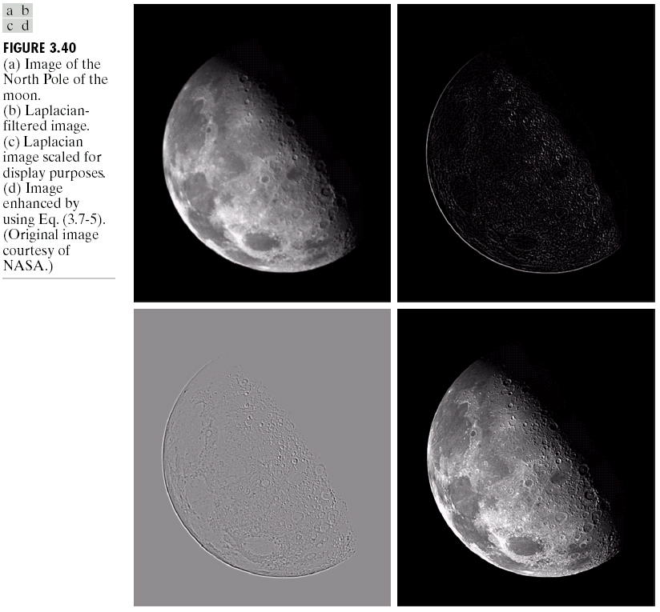
The Laplacian (cont…)
Applying the Laplacian to an image we get a new image that highlights edges and other discontinuities
Original Image
Laplacian Filtered Image
Laplacian Filtered Image Scaled for Display

Slide 66
But That Is Not Very Enhanced!
The result of a Laplacian filtering is not an enhanced image
We have to do more work in order to get our final image
Subtract the Laplacian result from the original image to generate our final sharpened enhanced image
Laplacian Filtered Image Scaled for Display

Slide 67
Laplacian Image Enhancement
-
=
Original Image
Laplacian Filtered Image
Sharpened Image
In the final sharpened image edges and fine detail are much more obvious

Slide 68
Laplacian Image Enhancement

Slide 69
Simplified Image Enhancement
The entire enhancement can be combined into a single filtering operation

Slide 70
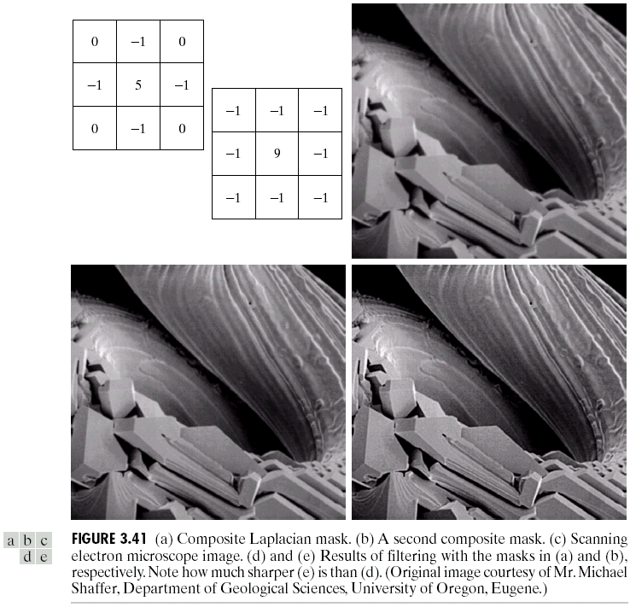
Simplified Image Simplified Image Enhancement (cont…)
This gives us a new filter which does the whole job for us in one step
0
-1
0
-1
5
-1
0
-1
0

Slide 71
Simplified Image Simplified Image Enhancement (cont…)

Slide 72
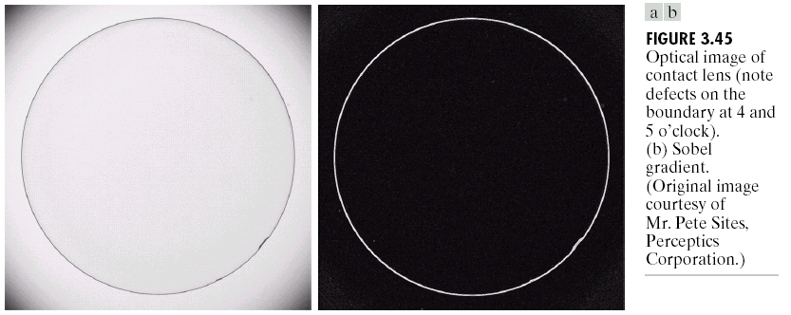
Sobel Example
Sobel filters are typically used for edge detection
An image of a contact lens which is enhanced in order to make defects (at four and five o’clock in the image) more obvious

Slide 73
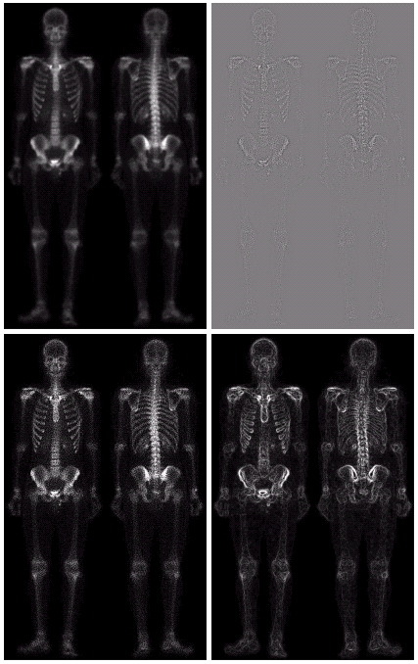
Combining Spatial Enhancement Methods
Successful image enhancement is typically not achieved using a single operation
Rather we combine a range of techniques in order to achieve a final result
This example will focus on enhancing the bone scan to the right

Slide 74
Combining Spatial Enhancement Methods
(a)
Laplacian filter of bone scan (a)
(b)
Sharpened version of bone scan achieved by subtracting (a) and (b)
(c)
Sobel filter of bone scan (a)
(d)

Slide 75
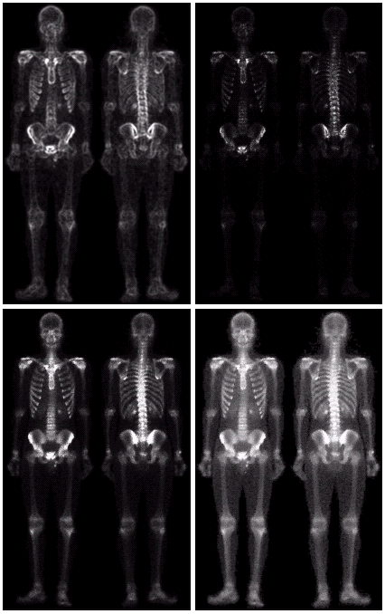
Combining Spatial Enhancement Methods
Sharpened image which is sum of (a) and (f)
The product of (c) and (e) which will be used as a mask
(g)
(f)
(e)

Slide 76
Combining Spatial Enhancement Methods
Compare the original and final images

Slide 77
THANK YOU

